Slide 1
Our Knowledge of the External World
Introduction to Philosophy
Philosophy 100
Class 6

Slide 2
Review
We are considering how, if ever, we come to knowledge.
The question is:
Can we know on the basis of reason alone, or does knowledge require experience?
Or might it be the case that we have no knowledge at all!?

Slide 3
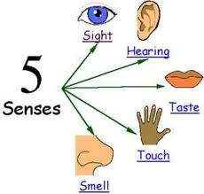
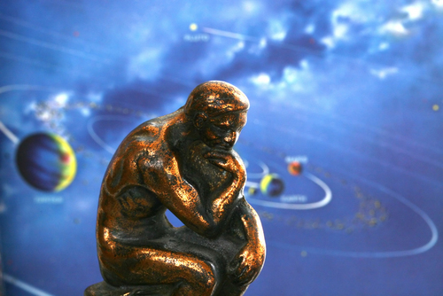
Two Camps
Rationalism
Empiricism
Reason is the primary source of knowledge. The fundamental truths of the world are knowable a priori: they are either innately known, or they are self-evident to our minds.
All knowledge of a subject or of concepts pertaining to a subject begin with experience.

Slide 4
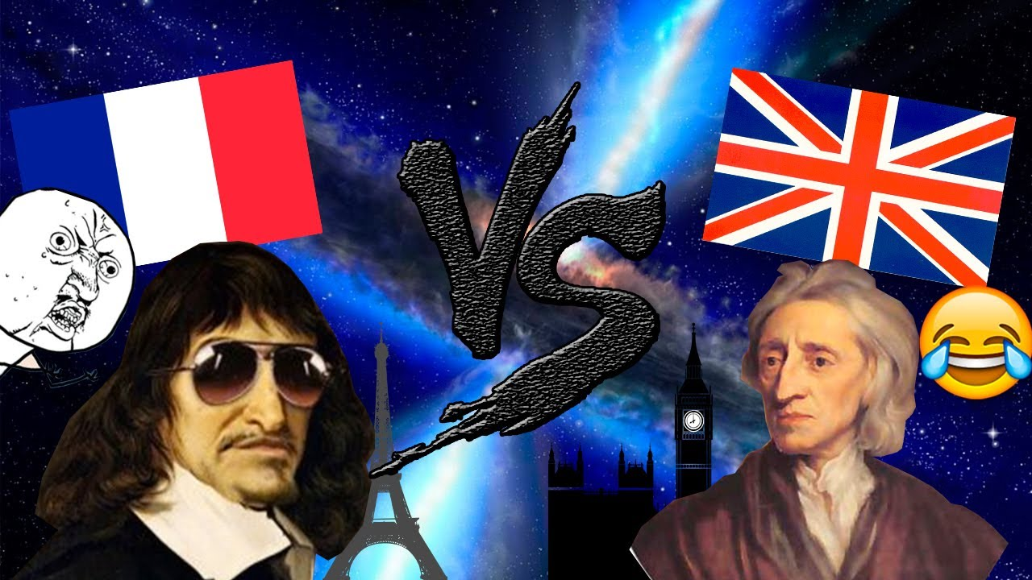
Descartes vs. Locke
Since “I exist” cannot be doubted, and we learned that from just sitting and thinking about it and not from sense experience, we have reason to think that a priori knowledge is much stronger than sense-based knowledge.
Therefore: RATIONALISM
Although the mind responds to the world in a way that cannot actually describe the world as it is, we need the world to know things. All of what we know comes from sensation and mental connections.
Therefore: EMPIRICISM

Slide 5
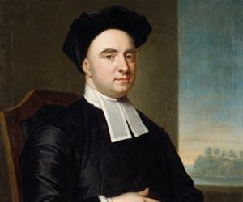
George Berkeley (1685 – 1753)
British-Irish Bishop
Defended empiricism a la Locke, but thought that Locke’s views were, in fact, a reason to deny material existence.
Was neither a skeptic, nor a solipsist.

Slide 6
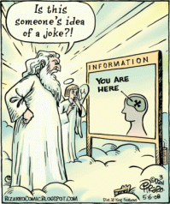
Berkeley’s Idealism
Berkeley defended a view that at first may sound quite crazy
He argued that there are no material objects
The only things in the universe are MINDS and the things in minds, which both Locke & Berkeley called “IDEAS”
Since he claims that the only things that exist are minds and ideas, Berkeley’s view is called
IDEALISM (= IDEA-LISM, not IDEAL-ISM)
You might think that Berkeley’s Idealism is crazy because he is denying the existence of trees and buildings and chairs and stones
But Berkeley DOES NOT deny the existence of trees and buildings and chairs & stones
He thinks that all of these things exist
And so do books and planets and pigs and all the rest of the ordinary things in the universe
What Berkeley denies is that these things are MATERIAL OBJECTS
He thinks they are all collections of IDEAS!

Slide 7
Berkeley’s Argument for Idealism
Berkeley was greatly influenced by Locke
1. He was particularly impressed by Locke’s argument that our ideas of secondary qualities did not resemble anything in the world outside of the mind
2. To establish that conclusion, Locke used the “variance argument” which showed that our ideas (i.e. perceptions) of the secondary qualities of objects could be very different … so they can’t ALL resemble some property of the object
3. Berkeley agreed that similar arguments could be offered for all the qualities that Locke had classified as secondary
a. Colors look different under different lighting conditions
b. Tastes are different depending on what you have just eaten
c. Smells are different depending on what you have been smelling recently … Etc.

Slide 8
Berkeley’s Argument for Idealism
Berkeley then went on to develop similar arguments for all of Locke’s “primary qualities”
1. Size: The size of our idea (= mental picture) of an object depends on how far away it is
2. Shape: The shape of our idea (= mental picture) of an object depends on the angle from which it is seen
3. Solidity: Water does not seem solid to us, but it would seem solid if we were as small as an insect
4. Motion: Whether or not our idea (= mental picture) of an object is moving depends on whether we are moving

Slide 9
Berkeley’s Argument for Idealism
Berkeley concluded that if material objects exist, then we can know nothing about them, since none of their properties resemble any of the properties of our ideas
1. So if material objects exist, they have no shape or size, they have no color, they are neither hot not cold, they are neither moving nor stationary
2. They are totally beyond our imagination. They are “unknown and inconceivable somethings”.
If we can’t know anything about them, Berkeley asked, why should we believe they exist at all?
Berkeley’s answer was that we shouldn’t!

Slide 10
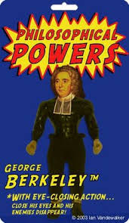
Berkeley’s Account of What Exists
The only things that exist are minds and ideas
There are no “material objects” which are defined as things that exist outside of any mind
There are all sorts of familiar physical objects -- shoes and ships and sealing wax and cabbages and kings
But they are not material objects; they are collections of ideas
For things that are not minds, to exist is to be perceived

Slide 11
Two Problems for Berkeley’s Idealism, 1
Unperceived Objects
Berkeley’s Response
What about a tree that no one ever sees? Does that mean that areas of the world—deep forests—that have never been perceived, thereby don’t exist?
First response: We don’t really think there are unperceived objects, since as soon as we think about such an object, we have an idea of it.
Objection: This conflates perceptions with other sorts of ideas.
Second (and much more powerful) response: A new argument for the existence of God.
We’ve already argued that physical objects are made up of ideas.
We are confident that physical objects exist when no human (or animal) mind is perceiving them.
So we should be equally confident that some other mind is perceiving them:
God’s mind!

Slide 12
Two Problems for Berkeley’s Idealism, 2
The Causes of Our Perceptions
Berkeley’s Response
Locke and others who believe in material objects think that material objects cause our perceptions
Obviously, this can’t be Berkeley’s answer since he the only thing we perceive are ideas
Berkeley agrees with Locke that our perceptions are not under our own control and must be caused by something independent of our minds.
But perceptions are not caused by matter, since matter does not exist.
Only a mind can cause an idea. So our perceptions must be caused by a mind … God’s mind!

Slide 13
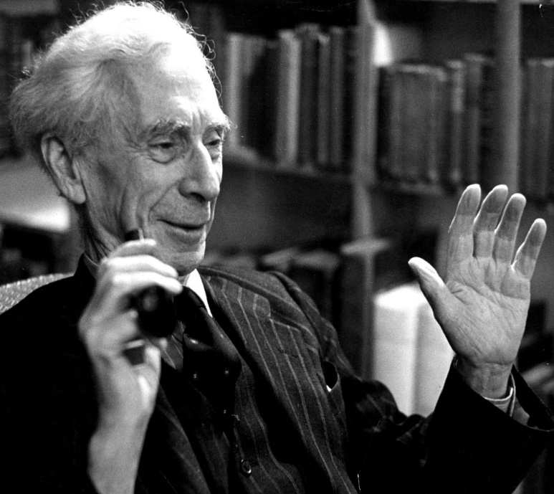
Bertrand Russell (1872 – 1970)
British Philosopher
Originator of Analytic Philosophy
Most important philosopher in the 20th Century
Worked on mathematics, logic, epistemology, metaphysics, war and peace, ethics, education, religion, social justice, and the good life.
Won the Nobel Peace Prize

Slide 14
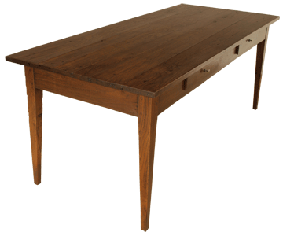
Appearance and Reality
Take an everyday experience-based belief: the table is wooden, rectangular, and hard.
Colour:
the table appears to be one colour in a certain light, but another from a different perspective. With no light there is not colour. Or we could be wearing colored glasses. What appears to be the table’s color is simply a matter of perspective.
Shape:
We infer that the table is rectangular, but this inference is based on experiences and our expectations of the table, nowhere in how the table appears is it rectangular.
Texture:
take a microscope, the table is not smooth as it appears, with a closer look there are hills and valleys in the table. We cannot judge what the actual shape is, but rather only how we see the table.
Hardness.
When we knock on the table, we can feel that it is hard. But this feeling depends on how hard we push.

Slide 15
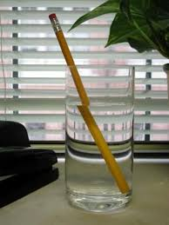
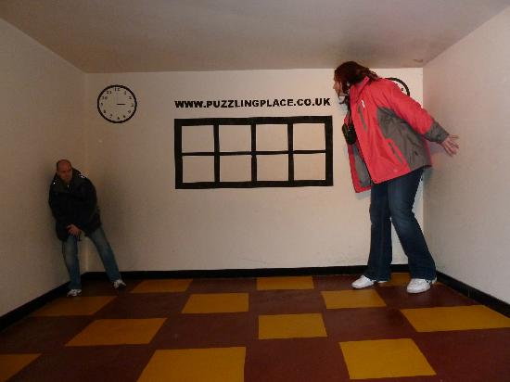
Optical Illusions
Shape
Size

Slide 16
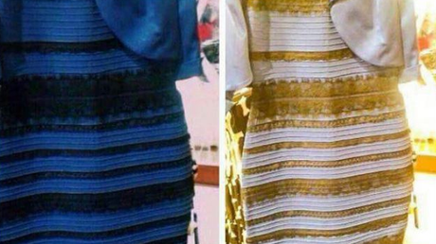
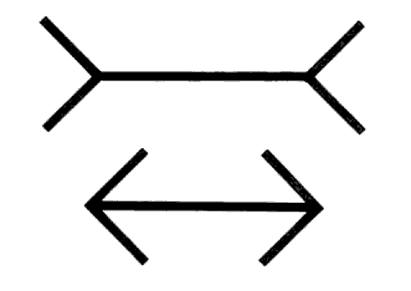
Illusions
Colour
Length

Slide 17

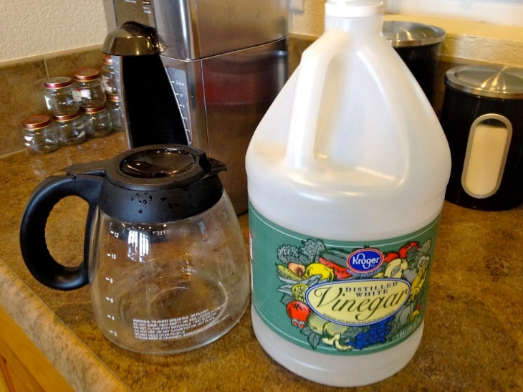
Illusions
Texture
Taste

Slide 18
Appearance and Reality
“It has appeared that, if we take any common object of the sort that is supposed to be known by the senses, what the senses immediately tell us is not the truth about the object as it is apart from us, but only the truth about certain sense-data which, so far as can be seen, depend on relations between us and the object. Thus, what we directly see and feel is merely “appearance,” which we believe to be a sign of some “reality” behind. But if reality is not what it appears, have we any means of knowing whether there is any reality at all? And if so, have we any means of finding out what it is like?”
Sense data: the things immediately known in sensation—colors, hardness, smell, roughness.
If we know anything about the table it is by way of our sense-data.

Slide 19
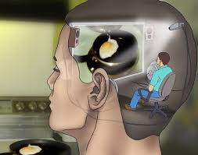
Problem of Perception and Our knowledge of the External World
The Ego-Centric Predicament
How can we go beyond the theater of consciousness?

Slide 20


